Slide 1

BDSN ASSIGNMENT
Submitted by :- ISHAAN NIRMAL (A21015)

Slide 2
BACKGROUND
In this emerging tech world every small to large scale businesses are going online in order to increase their sales but there is one common problem which all of them face – How to target more and more customers so that they spend more on their products and how to predict what amount is the new customer is gonna spend in the ecommerce platform .
Here comes the use of predictive analysis but why is predictive analysis important for ecommerce platforms , the answer is simple – “Predictive analytics enables e-commerce businesses to understand what products customers are looking for, helps in identifying popular and not-so-popular products and product categories”.

Slide 3
OBJECTIVE
The objective of this project is that we have the dataset of an ecommerce business we will examine that data and then we will build a linear regression model which will predict the customers yearly spend on the company’s product .

Slide 4
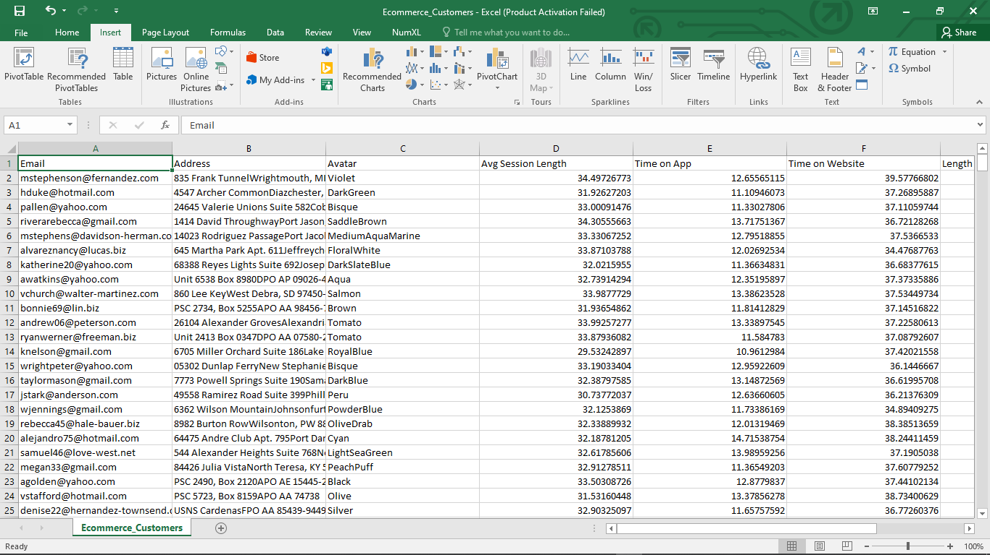
DATASET

Slide 5
DATASET COLUMN DESCRIPTION
EMAIL- consist up of the email id’s of the customers
AVATAR
ADDRESS – consist up of the delivery address / main address of the customers
AVG SESSION LENGTH – average amount of time spent by customer
TIME ON APP – time spent by customers on the app
TIME ON WEBSITE – time spent by customers on the website
LENGTH OF MEMBERSHIP – time for which customers have been the members
YEARLY SPENT AMOUNT – amount spent by the customer on yearly basis

Slide 6
FLOW OF PROJECT & TOOLS USED
The project has been done on google collab and the tools used are
SPARK
PYTHON

Slide 7
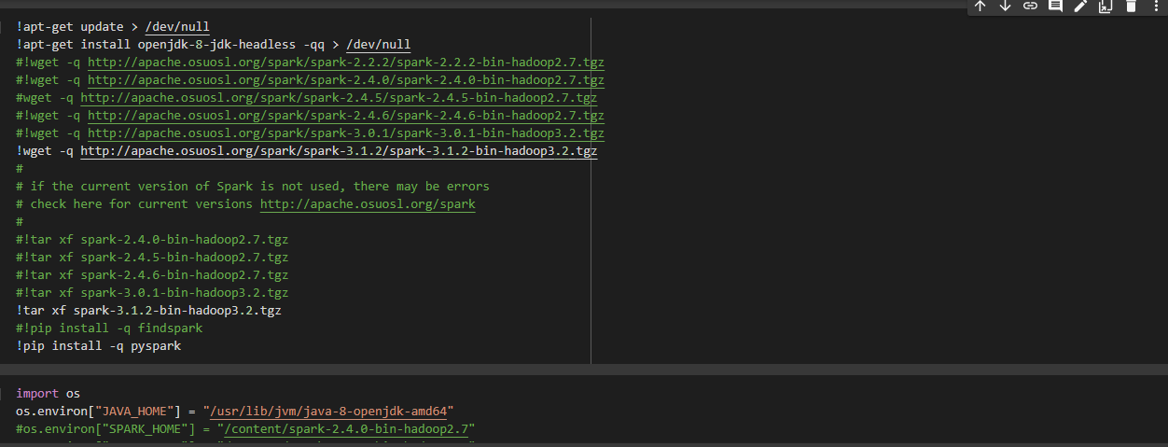
Creating the environment
First of all we will create the working environment for spark in google collab as displayed in the picture below .

Slide 8
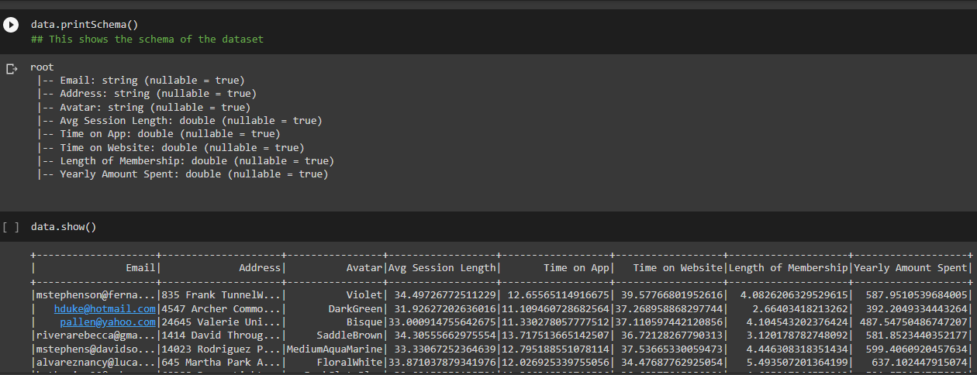
CHECKING THE SCHEMA OF DATA & NULL VALUES
We checked the schema of the data & found that the schema of the data provided was right nad there was no need of changing or transforming the schema
Then we checked for the null values and found that there were no null values present in the dataset .

Slide 9
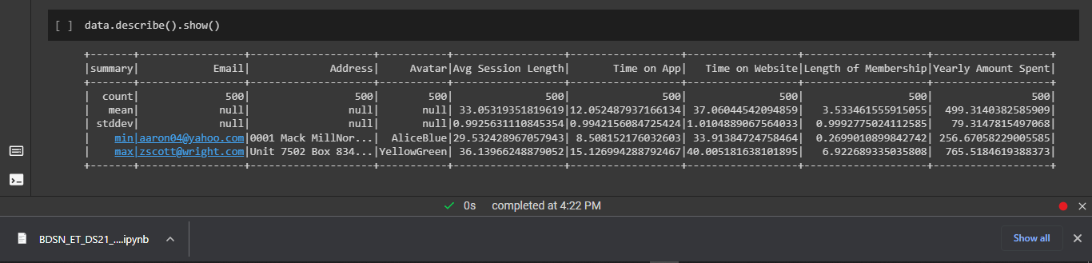
GENERAL STATS
Before going for the modelling part of the data we just saw an overview of the description of the data .

Slide 10
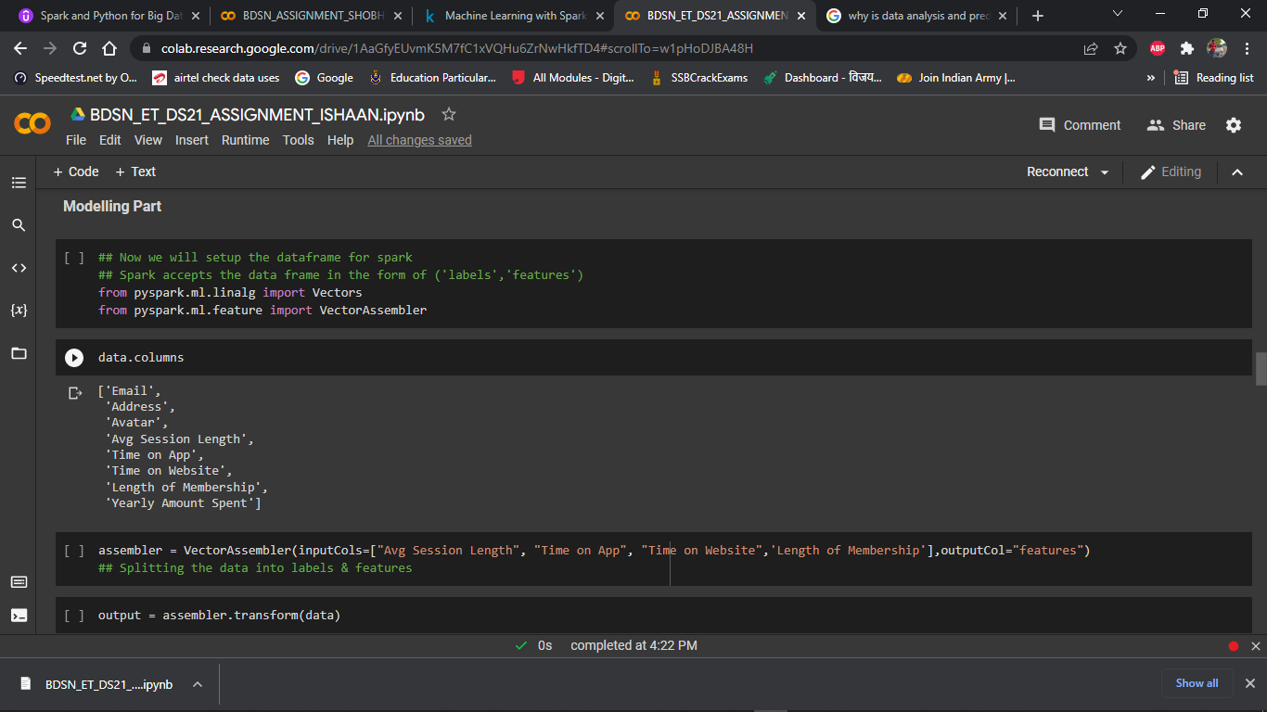
MODELLING PART
For the modelling process since we are doing this project using spark we had to change the data frame .
So we changed our dataframe , we did that because spark accepts the dataframe in the form of “labels” & features .
we did this using the vector assembler library .

Slide 11
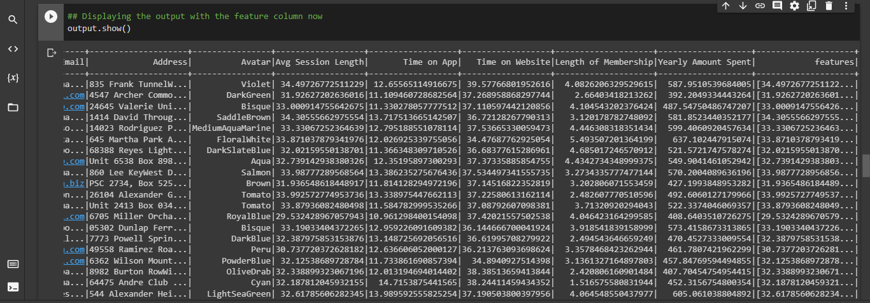
After using the vector assembler library we got a new column named features which is a form of vector and the dataframe now looked like this .

Slide 12
MODEL USED
We used a linear regression model here because the we were doing the analysis on a continuous set of data
So to start the modelling process we first of all split the data set into training and test data .
Training data – is used to train the model
Test data – is used to validate the model
We split the data set by 70:30 ratio

Slide 13
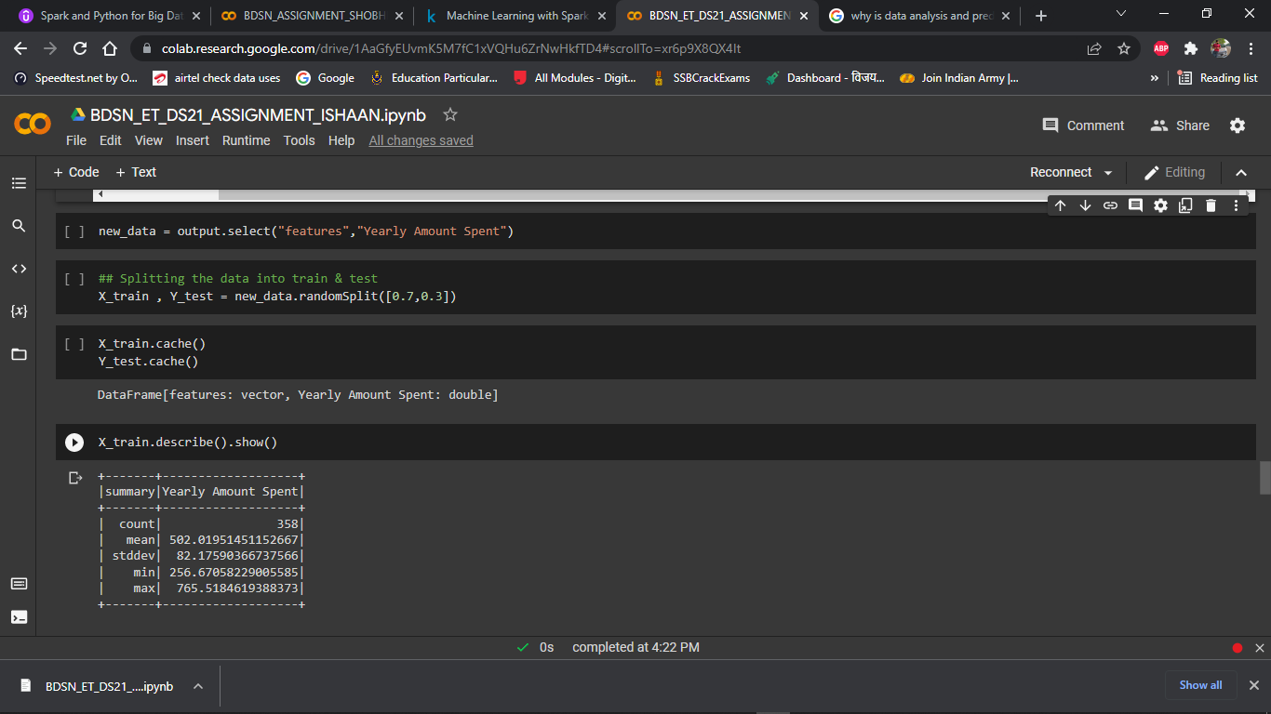
70 being the training data
30 being the test data

Slide 14
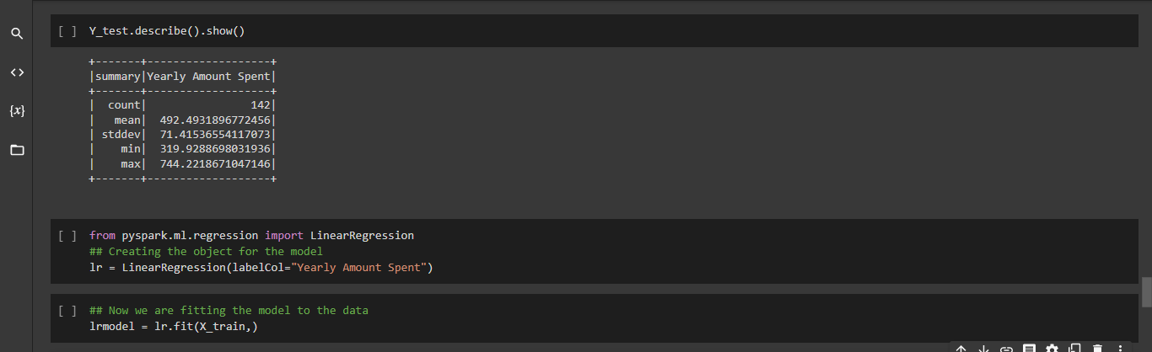
After splitting up the data set we called the linear regression library of spark
We trained the model .

Slide 15
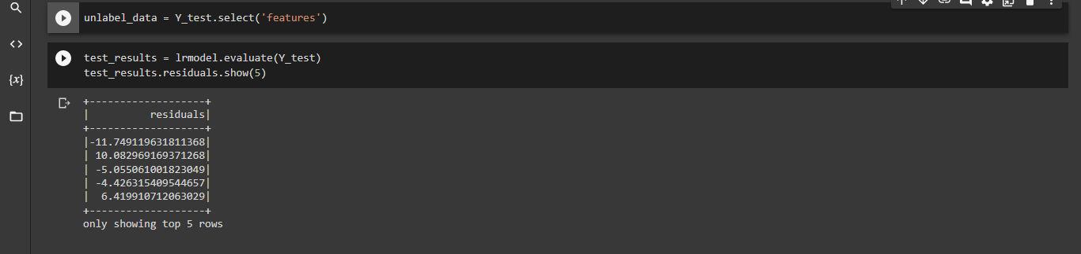
Now after training the mode l our next job was to fit the model
So we did that with our test data .

Slide 16
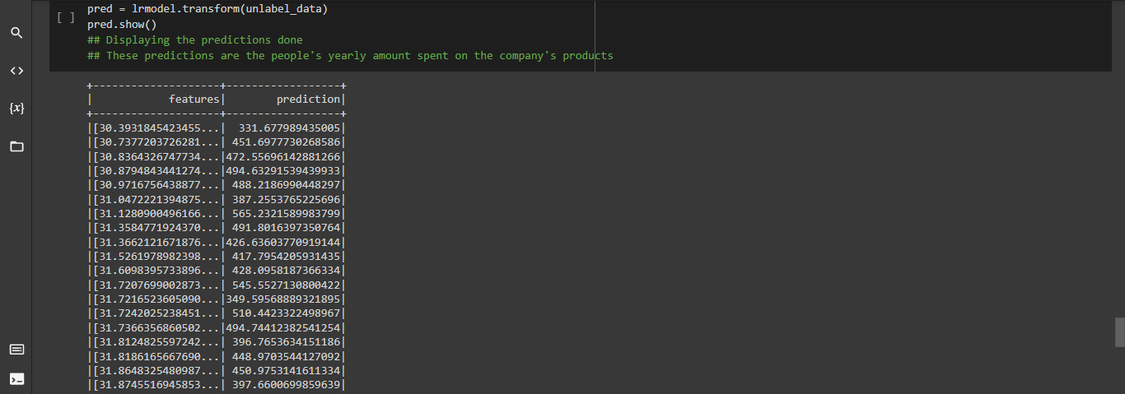
Now after fitting the data the next step was to see the prediction of the model so we got the following output as the prediction output .

Slide 17
So these were the predictions obtained after fitting the model .
Now we got the coefficient and the intercepts for the model .
What is a co-efficient – The values which multiply the predictor values .
What is an intercept – The expected value of Y when X =0 .

Slide 18
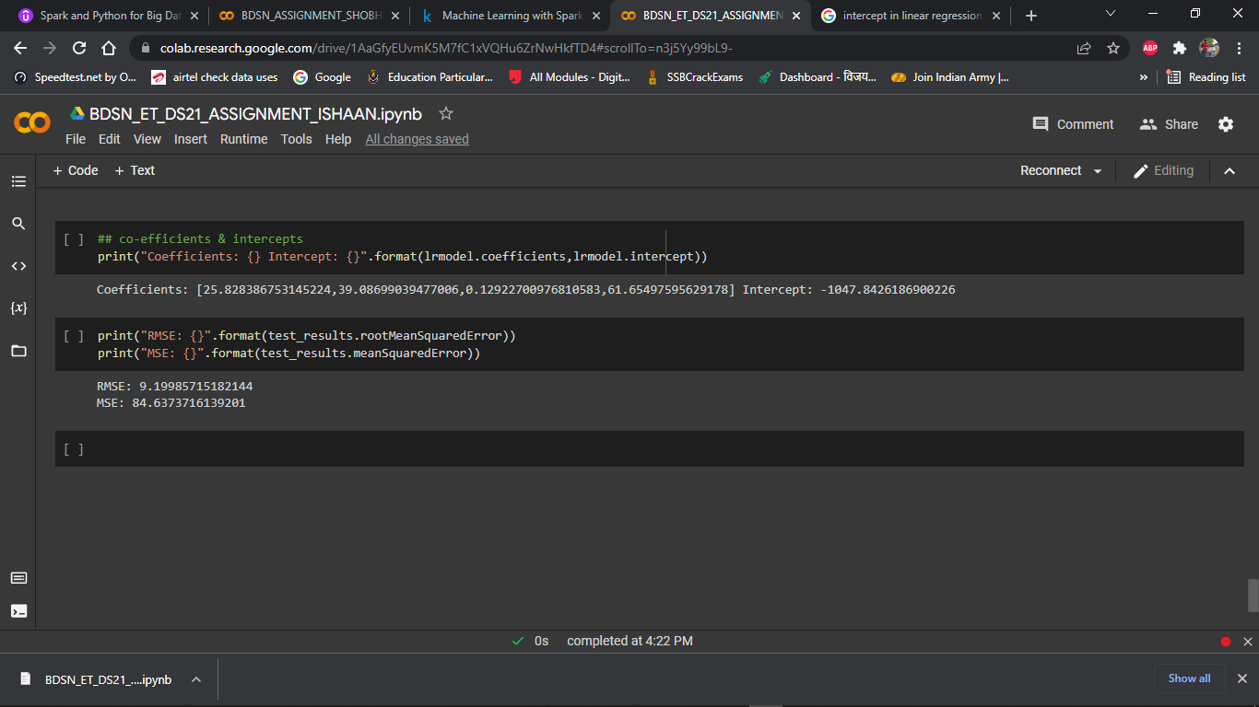
These were the values of co-efficients & intercept that were obtained .

Slide 19

Next we calculated the MSE & RMSE values which is displayed below
RMSE – standard deviation of the residuals .
MSE - how close a regression line is to a set of points

Slide 20
So basically our objective for this project was to predict the yearly spent and we have achieved that objective using the linear regression model .
This brings us to the end of this project .

